Slide 1
P&L & Metrics
17 June 2020

Slide 2
Content
High level FY2020 P&L vs FY2021
Key Metrics – understanding and financial impact
Missed Opportunities $
Questions

Slide 3
Service P & L – Sales

Slide 4
Service P & L – Direct Expenses

Slide 5
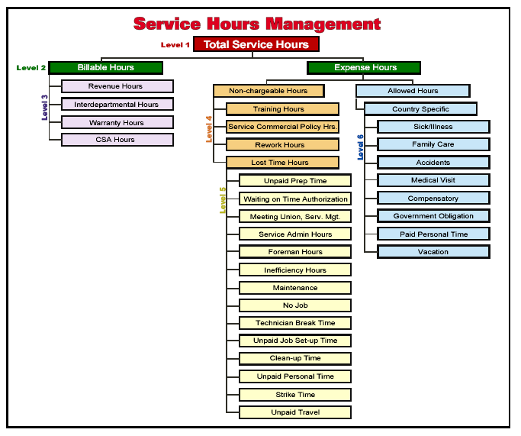
Service Hours Breakdown
LABOUR UTILISATION
(Billable Hours / Total Service Hours)
LABOUR PRODUCTIVITY
(Billable Hours / *Attended Hours)
(*Attended Hours = Total Service Hours – Allowed Hours)

Slide 6
LABOUR PRODUCTIVITY %
TARGET – 83.5%
Opportunity (P&L Impact):
?

Slide 7
LABOUR PRODUCTIVITY
TARGET – 83.5%
Opportunity (P&L Impact):
↑ Labour sales at no additional labour cost
↓ Direct expenses via reduction in expensed time
↑ Outwork sales
↑ Parts sales
↑ Increase recoveries
↑ PADE (Profit After Direct Expenses)

Slide 8
LABOUR PRODUCTIVITY
TARGET – 83.5%
Opportunity (P&L Impact):
↑ Labour sales at no additional labour cost
↓ Direct expenses via reduction in expensed time
↑ Outwork sales
↑ Parts sales
↑ Increase recoveries
↑ PADE

Slide 9
LABOUR PRODUCTIVITY
AREAS OF IMPROVEMENT:
Advance Job Planning
Scheduling – leverage digital app benefits
Marketing
CSAMs
Technician on Loan

Slide 10
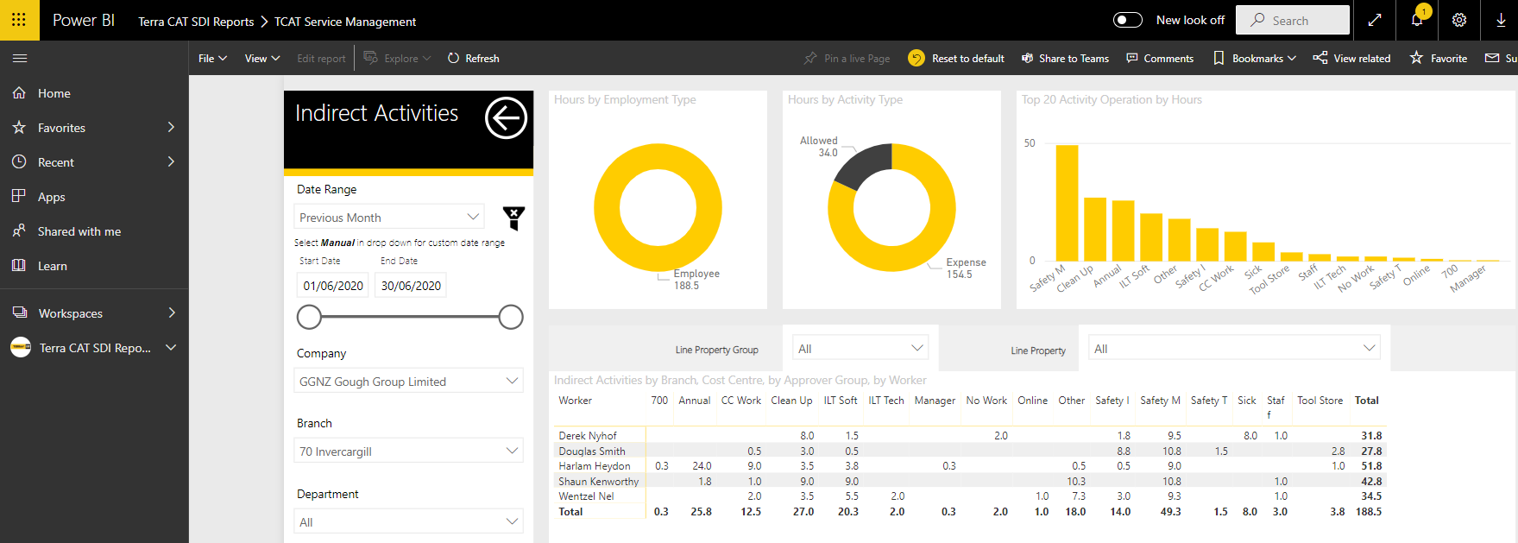
LABOUR PRODUCTIVITY
Power BI – Indirect Activities Reporting

Slide 11
LABOUR EFFICIENCY %
Formula:
1 + (FR Labour Variance $/Labour Sales $)
Example:
Labour of $1,000 put on job, $950 invoiced to customer.
1 + (-$50/$1,000)
1 + (-5%)
= 95%
LABOUR PRODUCTIVTY – represents how productive a technician is based on the time utilisations.
LABOUR EFFICENCEY – represent how much of the productive time is recoverable

Slide 12
LABOUR EFFICIENCY %
TARGET – 102%
Opportunity:
↑ Labour sales recovery at no additional labour cost
↑ Labour Margin
FY2020 Ext Labour 60.6% > 65.1 if we achieved 100% labour efficiency
↑ PADE (Profit After Direct Expenses)

Slide 13
LABOUR EFFICIENCY
TARGET – 102%
Opportunity:
↑ Labour sales recovery at no additional labour cost
↑ Labour Margin
FY2020 Ext Labour 60.6% > 65.1 if we achieved 100% labour efficiency
↑ PADE (Profit After Direct Expenses)

Slide 14
LABOUR EFFICENCY
AREAS OF IMPROVEMENT:
Quoting - correct – no surprises
Signed Work Authorisation
Supervision
Better internal communication on expectations – job opening
Matching correct skill set to jobs
WIP Management

Slide 15
OVERTIME HOURS %
Formula:
(Overtime hours + Premium Hours) / Total Service Hours
Example:
Standard Hours 40
Overtime Hours 5
Premium Hours 5
Total Service Hours 50
Overtime Hours % = (5+5)/50 = 20%

Slide 16
OVERTIME HOURS %
TARGET – 10%
Opportunity (P&L Impact):
↓ Average Labour Cost
↑ Labour Margin
↑ PADE (Profit After Direct Expenses)
Potential areas of focus:
Scheduling
Approval for additional hours
Explore flexible working hours to meet needs
*Need to be considered in conjunction with labour productivity

Slide 17
DIRECT EXPENSES – Other big Rocks
VEHICLE COST & RECOVERY
MV lease and running cost
MV recoveries
Revenue vehicle utilisation – 60%
SERVICE REDO
FY2020 $746K, 2% of service Sales (Target 1%)
Potential areas of focus:
Matching correct skillset to jobs
Supervision
Training
WIP MANAGEMENT
Cashflow
Labour Efficiency

Slide 18
Service Driver Tree – Big Rocks
Profit After Direct Expenses
Sales
Expenses
Gross Profit
Margin
LRV – Labour Efficiency
Productivity
Personnel Expenses
Vehicles
Goodwill & Redo
Overtime

Slide 19
Parts P & L – Sales

Slide 20
Parts P & L – Direct Expenses

Slide 21
Parts – Key Drivers
POPS-C – Percentage of Part Sales
(31.6% - Target 40.0%)
CSAM
Marketing
Hose Sales
Parts.cat.com
OLGA opportunity
Increase Labour Sales
Data cleanse > real opportunities
Parts Availability – stock accuracy
MARGIN %
Customer base
Discounts – validations
Commodity Mix
DIRECT EXPENSES
Staff Expenses
- HC requirements
- Internet Sales
Freight Cost & Recovery
- Value add freight activity
Profit After Direct Expenses
Sales
Gross Profit
Retail & Internal Margin
POPs
Personnel Expenses
Freight recovery's
Expenses

Slide 22
Parts – Key Drivers
POPS-C
Service Labour Productivity Impact
FY2020: 73.0% vs Target 83.5% (10.5%)
Unsold Hours Opportunity: 10.5% = 42,792 hours
Parts per sold labour hour run rate: $124.65
Parts Sales Opportunity = $5.3M
POPS-C 31.6% >33.5%

